Slide 1


SASCAP+
~ Safety and Security ~

Slide 2
SASCAP+
~ Safety and Security ~

Slide 3
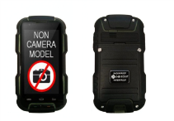


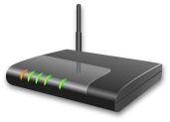
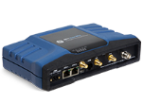
INTRODUCTION
SASCAP+ is an integrated and customizable safety and security solution that combines state-of the-art infrastructure and system solutions
Modules
Products
Descriptions
Navigation
Monitoring
Radio-over-IP
Software Application
Mobile application and web based application
Location Tracking
Communication
Non-Camera purpose-built ruggedized smartphone preinstalled with communication application
Workflow
Security pass with beacon for location tracking
Infrastructure Solution (Indoor/Outdoor)
Beacons: mounted on walls to transmit proximity info
Wifi router and extender: to setup long range communication infrastructure over 75 miles
Cellular Wifi router: to setup and interconnect Wifi with cellular network

Slide 4
SASCAP+
BUSINESS MODEL
Strategic Services
WORKFLOW
INFRASTRUCTURE
LOCATION SERVICE
PROCESS CHANGE
SAFETY
SECURITY
Vertical Focus (Sectors/Industries)
TRANSPORTATION
RETAIL
HEALTHCARE
HOSPITALITY
CONSTRUCTION
...

Slide 5




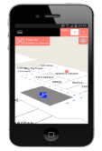

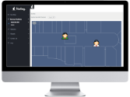


SASCAP+
From long range WiFi of up to 100km to proximity precision of 2m, SASCAP+ deploy secured infrastructure solutions (Air-gap) to specific needs
INFRASTRUCTURE
* Internet Cloud Services
INTERNET CLOUD
Central monitoring console
Mobile app for tracking and communicating
*Air Gap Solution – No internet required
INTRANET
Central monitoring console
Mobile app for tracking and communicating

Slide 6







SASCAP+
SASCAP+ provides a customizable, intelligent solution for monitoring the level of security and communication in the field of security
WORKFLOW
Alerting of detected event triggers or manual initiated notifications
Displaying checklists for safety/security checks and compliance
Storing of documents for records and analysis
Notification
inputs/outputs
Document Libraries
Checklists
FUNCTIONS
Communicator
Schedules
Statistics and Reports
Facilitating info delivery and exchange to different parties
Recording and displaying of time tables , events and plans
Generated statistics and reports for periodic analysis and reporting

Slide 7


















































SASCAP+
SASCAP+ utilizes technology to identify and provides accurate location of interest.
LOCATION SERVICE

Slide 8
Use Case Scenario
Safety & Security Command (Retail)

Slide 9

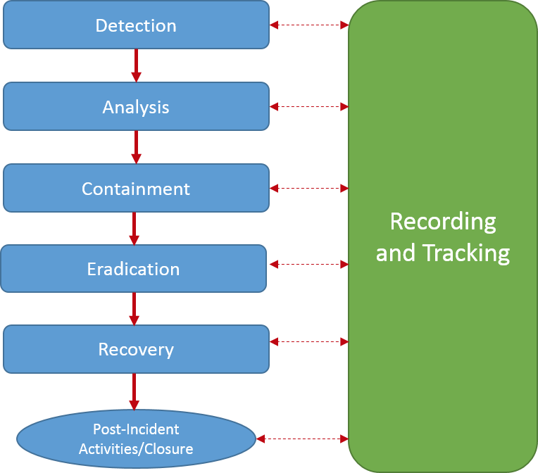

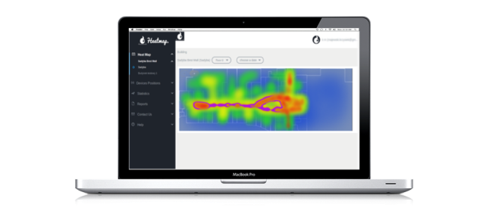
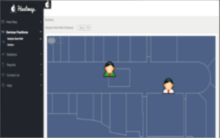
Safety & Security Command (Retail)
INCIDENT
Security officers require a simple and effective System Solution to record and track the incidents

Slide 10
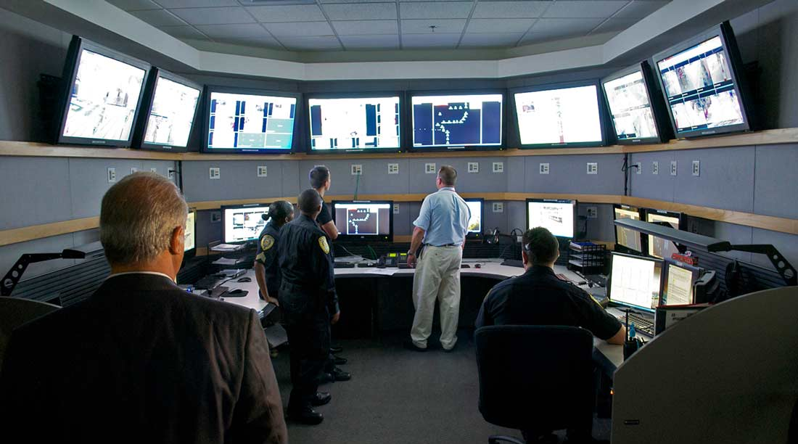




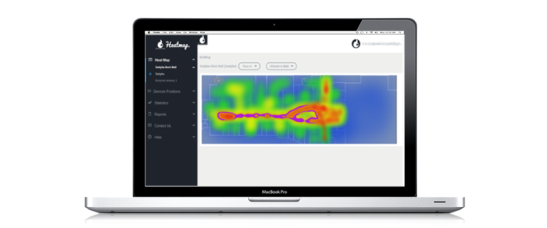

Location Identifcation
Location Monitoring
Location Identifcation
Heat Map / Location Statistic
RoIP Communication System
Smartphone with communication application will be issued to security officer to communicate with one another and control center
In sight of security hazards, security officers can immediately report the incident by taking a picture via the app. The location, time of incident is properly and automatically recorded into the System
Communication &
Monitoring Systems

Slide 11

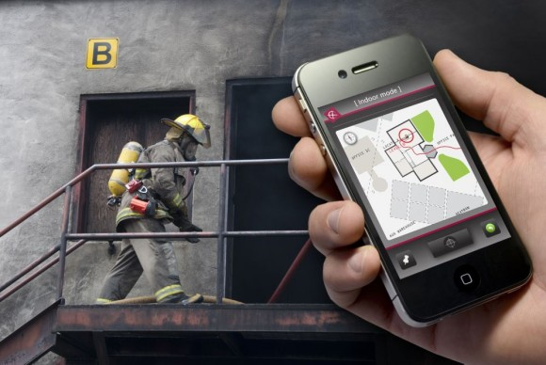
Location Identifcation
Location Reporting
Location Identifcation
Heat Map / Location Statistic
RoIP Communication System
Incident Responders such as fire fighters can immediately identify and attend to the incident area through the location mobile application
The external parties can easily communicate with the security team on support or progress
Security officers can record incident closure properly into the System
Communication &
Monitoring Systems

Slide 12
Location Identifcation
Location Monitoring
Location Identifcation
Heat Map / Location Statistic
RoIP Communication System
Smartphone with communication application will be issued to security officer to communicate with one another and control center
In sight of security hazards, security officers can immediately report the incident by taking a picture via the app. The location, time of incident is properly and automatically recorded into the System
Communication &
Monitoring Systems

Slide 13
Location Identifcation
Location Reporting
Location Identifcation
Heat Map / Location Statistic
RoIP Communication System
Incident Responders such as fire fighters can immediately identify and attend to the incident area through the location mobile application
The external parties can easily communicate with the security team on support or progress
Security officers can record incident closure properly into the System
Communication &
Monitoring Systems

Slide 14

Contact
Kelvin Zheng
CEO
Innox Agile Pte Ltd
Mobile: +65 9144 1521
Email: kelvin.zheng@innoxagile.com
Website: http://www.innoxagile.com

Slide 15


Slide 16


